Slide 1
Physical Ergonomics:
Work Physiology
Sections:
Human Physiology
Muscular Effort and Work Physiology
Work Systems and the Methods, Measurement, and Management of Work
by Mikell P. Groover, ISBN 0-13-140650-7.
©2007 Pearson Education, Inc., Upper Saddle River, NJ. All rights reserved.

Slide 2
Physical Ergonomics - Physiology
Physical Ergonomics – concerned with how the human body responds to physical work activity (work physiology) and how the physical dimensions of the human body affect the capabilities of a worker (anthropometry)
Physiology - a branch of biology concerned with the vital processes of living organisms and how their constituent tissues and cells function
  Important in work because work requires functioning of the tissues (muscles, ligaments, bones) needing expenditure of physical energy
Work Systems and the Methods, Measurement, and Management of Work
by Mikell P. Groover, ISBN 0-13-140650-7.
©2007 Pearson Education, Inc., Upper Saddle River, NJ. All rights reserved.

Slide 3
Human Physiology
Human musculoskeletal (muscles and bones) system
  Primary actuator for performing physical labor and other activities requiring force and motion
  Composed of muscles and bones connected by tendons
    206 bones in human body: provide protection for vital organs (skull), a framework for physical activity (bones in the legs)
    Energy to perform physical activity provided by metabolism
  Bones are connected to each other at their joints by means of ligaments.
Work Systems and the Methods, Measurement, and Management of Work
by Mikell P. Groover, ISBN 0-13-140650-7.
©2007 Pearson Education, Inc., Upper Saddle River, NJ. All rights reserved.

Slide 4
Joint Types for Body Movement
Ball-and-socket – shoulder and hip joints
Pivot – neck
Hinge – elbow and knee
Ball-and-socket joints can apply greater force than pivot joint
Work Systems and the Methods, Measurement, and Management of Work
by Mikell P. Groover, ISBN 0-13-140650-7.
©2007 Pearson Education, Inc., Upper Saddle River, NJ. All rights reserved.

Slide 5
Muscle Types
Cardiac muscles: heart muscles that performs the pumping function for the cardiovascular system
Smooth muscles: in the intestines they accomplish peristalsis for food digestion, in the blood vessels they serve in the regulation of blood flow and pressure
Skeletal muscles
Work Systems and the Methods, Measurement, and Management of Work
by Mikell P. Groover, ISBN 0-13-140650-7.
©2007 Pearson Education, Inc., Upper Saddle River, NJ. All rights reserved.

Slide 6
Skeletal Muscles
Provide power for force and motion in the musculoskeletal system
Approximately 400 skeletal muscles, 40 percent of human body weight
They are attached to the bones by tendons
Blood vessels and nerves distributed throughout muscle tissue to deliver fuel and provide feedback
Work Systems and the Methods, Measurement, and Management of Work
by Mikell P. Groover, ISBN 0-13-140650-7.
©2007 Pearson Education, Inc., Upper Saddle River, NJ. All rights reserved.

Slide 7
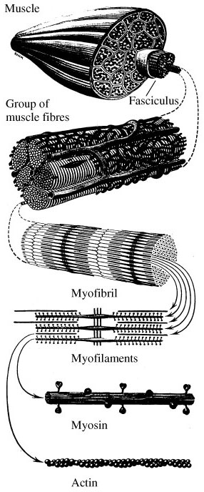
The structure of a muscle
Flesh tissue- bundles of long cells
Muscle fibers (0.1 mm-140mm): connective tissue to the bones, blood vessels, nerves
Myofibril
Protein filaments
  Myosin: thick filaments – long proteins
  Actin: thin filaments – globular proteins
  Two types are interlaced to contract (physical condition of the muscle when it is activated)
Work Systems and the Methods, Measurement, and Management of Work
by Mikell P. Groover, ISBN 0-13-140650-7.
©2007 Pearson Education, Inc., Upper Saddle River, NJ. All rights reserved.

Slide 8
Skeletal Muscle Contractions
Concentric muscle contraction – muscle becomes shorter when it contracts
Eccentric muscle contraction – muscle elongates when it contracts
Isometric muscle contraction – muscle length stays the same when it contracts
Work Systems and the Methods, Measurement, and Management of Work
by Mikell P. Groover, ISBN 0-13-140650-7.
©2007 Pearson Education, Inc., Upper Saddle River, NJ. All rights reserved.

Slide 9
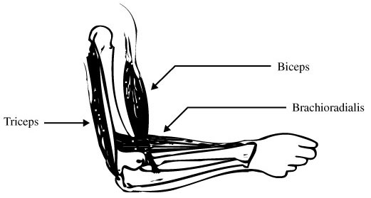
Skeletal Muscle Contraction
Skeletal muscles are organized in pairs
  Act in opposite direction about the joints that are moved by them
Open the elbow joint
    Triceps -> shorter (concentric c.), biceps->longer (eccentric c.)
  Close the angle of the elbow joint
    Triceps -> longer, biceps->shorter
  To hold an object in a fixed position
    Both contract isometrically
Work Systems and the Methods, Measurement, and Management of Work
by Mikell P. Groover, ISBN 0-13-140650-7.
©2007 Pearson Education, Inc., Upper Saddle River, NJ. All rights reserved.

Slide 10
Metabolism
Muscle contraction is enabled by the conversion of chemical energy into mechanical energy, the process is called metabolism.
Sum of the biochemical reactions that occur in the cells of living organisms
Functions:
  Provide energy for vital processes and activities, including muscle contraction
  Assimilate new organic material into the body
Work Systems and the Methods, Measurement, and Management of Work
by Mikell P. Groover, ISBN 0-13-140650-7.
©2007 Pearson Education, Inc., Upper Saddle River, NJ. All rights reserved.

Slide 11
Metabolism
Can be viewed as an energy rate process
  The amount of energy per unit time at which chemical energy (contained in food) is converted into mechanical energy / the formation of new organic matter.
Energy unit: kilocalorie (kcal)-the most commonly used one, kilojoule (kJ), Newton-meter (Nm), British thermal unit (Btu)
Energy rate unit: kcal/min-the most commonly used one, kJ/min, Nm/min, Btu/min
Work Systems and the Methods, Measurement, and Management of Work
by Mikell P. Groover, ISBN 0-13-140650-7.
©2007 Pearson Education, Inc., Upper Saddle River, NJ. All rights reserved.

Slide 12
Types of Metabolism
Basal metabolism – energy used only to sustain the vital circulatory and respiratory functions: the rate at which heat is given off by an awake, resting human in a warm location at least 12 hours after eating
Activity metabolism – energy associated with physical activity such as sports and manual work
Digestive metabolism – energy used for digestion
Work Systems and the Methods, Measurement, and Management of Work
by Mikell P. Groover, ISBN 0-13-140650-7.
©2007 Pearson Education, Inc., Upper Saddle River, NJ. All rights reserved.

Slide 13
Total Daily Metabolic Rate
Daily metabolic rates:
  TMR_{d} = BMR_{d} + AMR_{d} + DMR_{d}
  where
  TMR_{d} = total daily metabolic rate, kcal/day;
  BMR_{d} =daily basal metabolic rate, kcal/day;
  AMR_{d} =daily activity metabolic rate, kcal/day;
  DMR_{d} =daily digestive metabolic rate, kcal/day
Work Systems and the Methods, Measurement, and Management of Work
by Mikell P. Groover, ISBN 0-13-140650-7.
©2007 Pearson Education, Inc., Upper Saddle River, NJ. All rights reserved.

Slide 14
Total Daily Metabolic Rate: How to estimate components?
The basal metabolic rate: depends on the individual’s weight, gender, heredity, percentage of body fat, etc.
  For a 20-year old male, BMR_{h}//kg: 1.0 kcal per kg of body weight
  For a 20-year old female, BMR_{h}//kg: 0.9 kcal per kg of body weight
  Age correction: subtract 2% for each decade above 20 years
The activity metabolic rate: will be discussed
The digestive metabolic rate:
  DMR_{d} = 0.1 (BMR_{d} + AMR_{d} )
Work Systems and the Methods, Measurement, and Management of Work
by Mikell P. Groover, ISBN 0-13-140650-7.
©2007 Pearson Education, Inc., Upper Saddle River, NJ. All rights reserved.

Slide 15
Example: Daily Metabolism Rate
Given: a 35 year old women who weights 59 kg.
Determine: The daily basal metabolism rate.
Solution:
She is 1.5 decades older than 20 year
Age correction: 1.5(0.02)=0.03
BMR_{h}/kg=0.9(1-0.03)=0.873kcal/hr/kg of body weight
For 24 hours:
BMR_{d}=0.873(59)(24)=1238 kcal/day
BMR_{m}=1238/((24)(60))=0.86 kcal/min
Work Systems and the Methods, Measurement, and Management of Work
by Mikell P. Groover, ISBN 0-13-140650-7.
©2007 Pearson Education, Inc., Upper Saddle River, NJ. All rights reserved.

Slide 16
Biochemical Reactions in Metabolism
The liberation of chemical energy from food starts in the digestive track
Food categories:
  Carbohydrates (4 kcal/g) – converted into glucose (C₆H₁₂O₆) and glycogen
    Primary source of energy muscle
    Glycogen is stored in the muscles and changed into glucose as needed
  Proteins (4 kcal/g) – converted into amino acids
  Lipids (9 kcal/g) – converted into fatty acids (acetic acid and glycerol)
Work Systems and the Methods, Measurement, and Management of Work
by Mikell P. Groover, ISBN 0-13-140650-7.
©2007 Pearson Education, Inc., Upper Saddle River, NJ. All rights reserved.

Slide 17
Muscle Strength and Endurance
Apart from energy expenditure, another important factor is strength:
  the maximum torque that a given muscle can exert voluntarily about the skeletal joint
  the maximum force that can be applied by a muscle
Static strength – human subject applies as high a force as possible against an immovable object
  Duration of test is short (e.g., a few seconds)
  Results influenced by joint type (arm vs. leg) and joint angle
Dynamic strength – tested under conditions that involve changes in joint angles and motion speed
Work Systems and the Methods, Measurement, and Management of Work
by Mikell P. Groover, ISBN 0-13-140650-7.
©2007 Pearson Education, Inc., Upper Saddle River, NJ. All rights reserved.

Slide 18
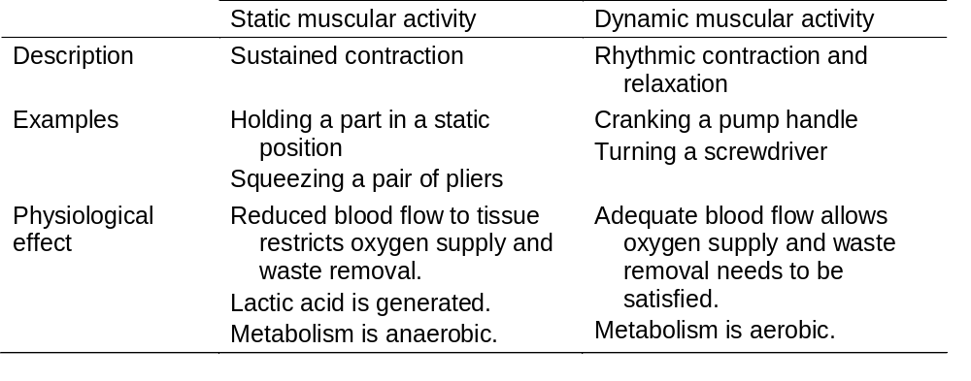
Static vs. Dynamic Muscular Activities
Dynamic muscle effort is physiologically less costly to the muscles compared to the static effort
Work Systems and the Methods, Measurement, and Management of Work
by Mikell P. Groover, ISBN 0-13-140650-7.
©2007 Pearson Education, Inc., Upper Saddle River, NJ. All rights reserved.

Slide 19
Factors Affecting Strength
The static strength differences between the strongest and the weakest workers can be as much as 8 to 1.
Size (e.g., height, body weight, build)
Gender
  Average strength of females is 67% of the males’
Age
  Maximum strength at age 25 to 35
  About 80% of peak in mid-fifties
Physical conditioning
  Physical exercise can increase strength by as much as 50 percent
Work Systems and the Methods, Measurement, and Management of Work
by Mikell P. Groover, ISBN 0-13-140650-7.
©2007 Pearson Education, Inc., Upper Saddle River, NJ. All rights reserved.

Slide 20
Muscle Endurance
Muscle endurance is defined as the capability to maintain an applied force over time
  Ability to maintain maximum static force lasts only a short time
  After about 8 to 10 minutes, a person can only apply about 23% of maximum static force achieved at beginning of test
Work Systems and the Methods, Measurement, and Management of Work
by Mikell P. Groover, ISBN 0-13-140650-7.
©2007 Pearson Education, Inc., Upper Saddle River, NJ. All rights reserved.

Slide 21
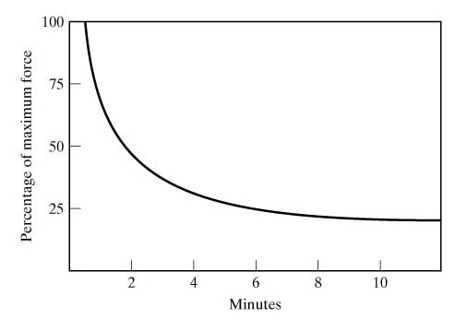
Muscle Endurance
Work Systems and the Methods, Measurement, and Management of Work
by Mikell P. Groover, ISBN 0-13-140650-7.
©2007 Pearson Education, Inc., Upper Saddle River, NJ. All rights reserved.

Slide 22
Dynamic Muscle Activity vs Static Force
Dynamic muscle activity (requiring dynamic force application) in a repetitive motion cycle
  Muscle fatigue - applied dynamic force declines over time (a similar curve)
  The decline is slower than in the case of an applied static force: the bottom level is higher than 23%.
Work Systems and the Methods, Measurement, and Management of Work
by Mikell P. Groover, ISBN 0-13-140650-7.
©2007 Pearson Education, Inc., Upper Saddle River, NJ. All rights reserved.

